Slide 1
AI & Machine Learning
AI Introduction & Python Foundations
Dr. Tariq Sadad

Slide 2
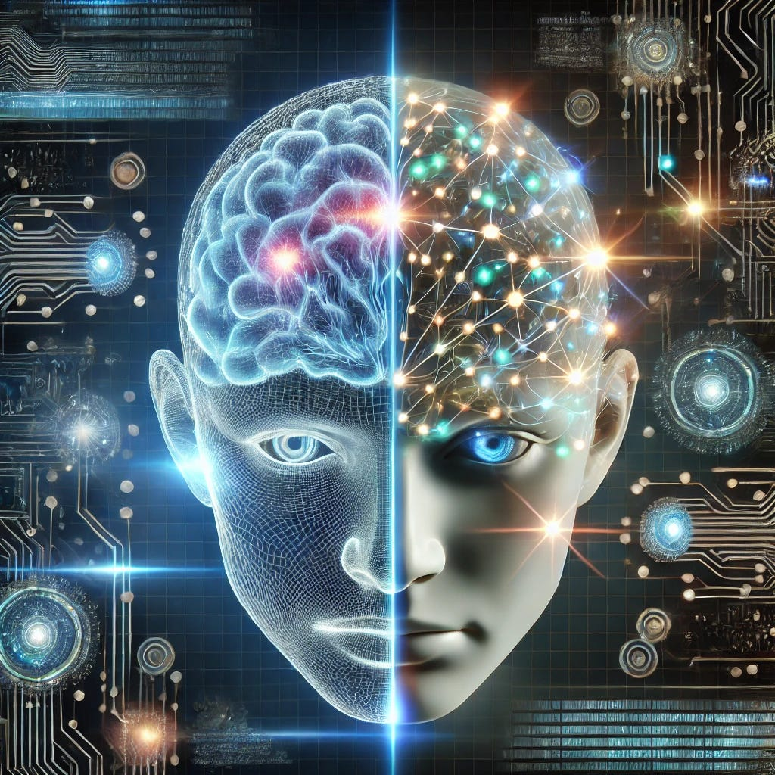
What is Artificial Intelligence (AI)?
AI is the ability of machines to:
Think intelligently
Learn from data
Make decisions
Solve problems like humans
In short: Machines that act smart

Slide 3

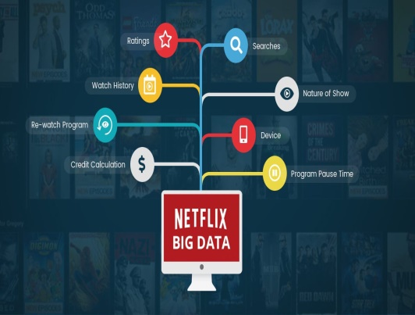

AI IN DAILY LIFE
AI in Our Daily Life
Google Maps → best route
YouTube/Netflix → recommendations
Mobile Face Unlock
Email Spam Filter
Chatbots
Reality Check: You already use AI every day

Slide 4
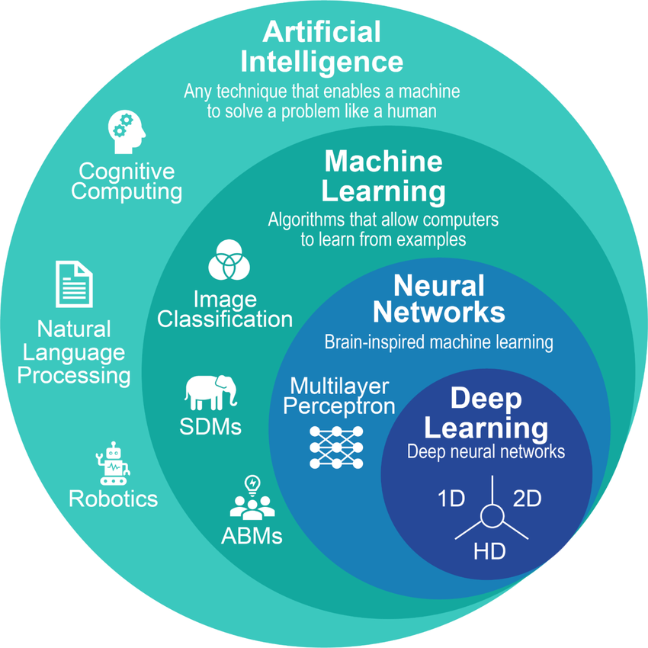
AI vs ML vs DL vs GenAI (CORE CONCEPT)
Relationship Between AI, ML, DL & GenAI
AI → Goal (intelligence)
ML → Learning from data
DL → Neural networks
GenAI → Content creation
Hierarchy: AI ⟶ ML ⟶ DL ⟶ GenAI

Slide 5
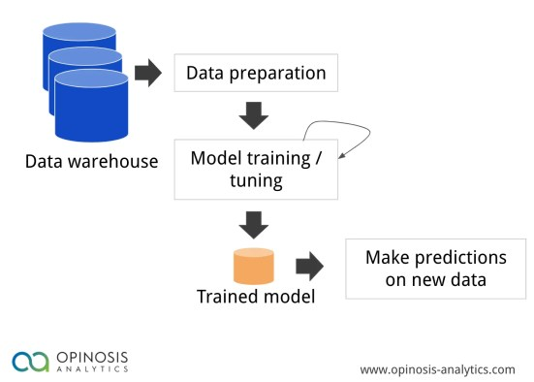
WHAT IS MACHINE LEARNING?
ML allows systems to:
Learn patterns from data
Improve automatically
Predict outcomes
Examples:
Student result prediction
Fraud detection
Disease prediction

Slide 6
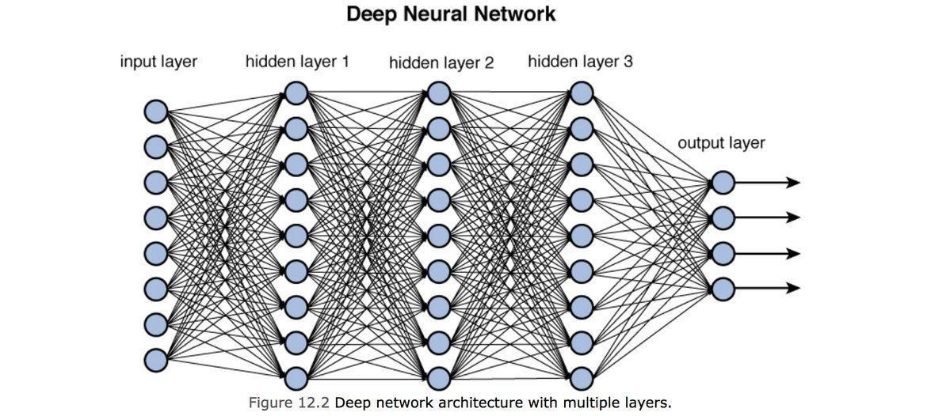
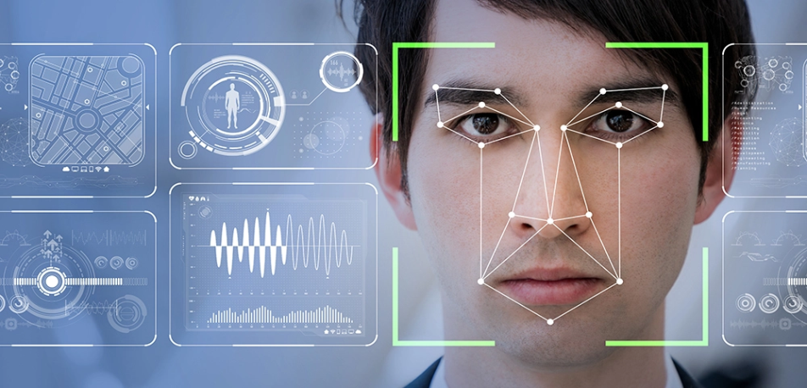
WHAT IS DEEP LEARNING?
DL Uses Artificial Neural Networks
Works best with:
Images
Audio
Video
Text
Applications:
Face recognition
Speech recognition
Medical imaging

Slide 7
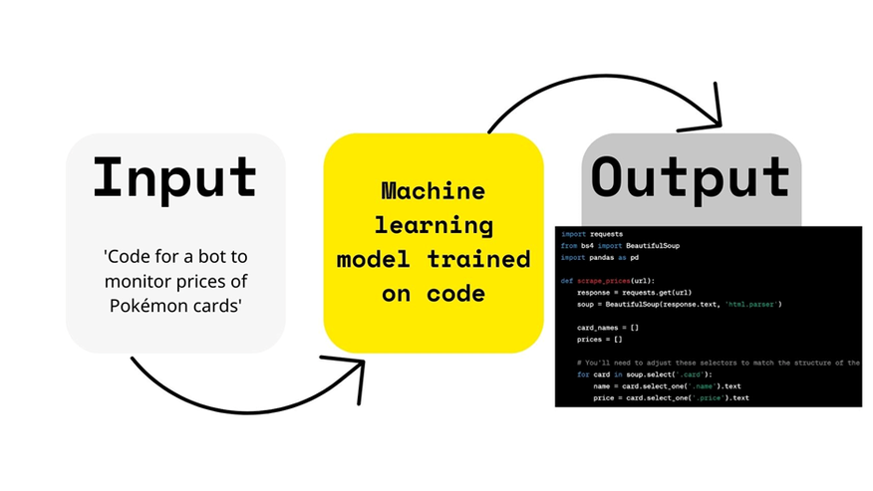
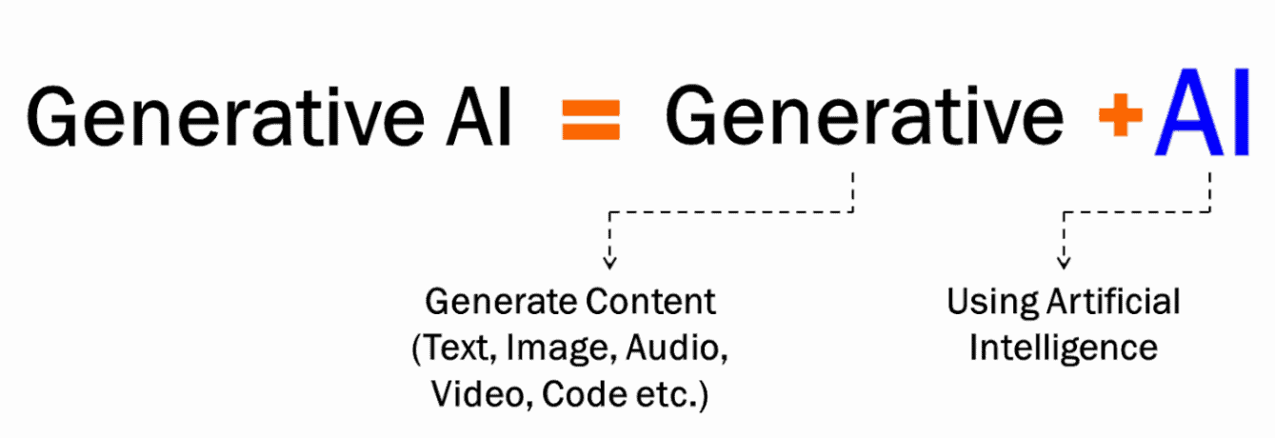
WHAT IS GENERATIVE AI?
Generative AI can create new content:
Text
Images
Code
Audio
Video
Key Difference: Traditional AI predicts, GenAI creates

Slide 8

EVOLUTION OF AI (TIMELINE)
1950 – Can Machines Think?
Alan Turing proposes the Turing Test
Goal: test machine intelligence
1956 – Birth of AI
Term Artificial Intelligence introduced
AI becomes a research field
1960s–70s – Rule-Based AI
Machines follow fixed rules
No learning from data
Example: early chatbots (ELIZA)
1970s–90s – AI Winter
Limited data & computing power
Funding and progress slow down
1997 – First Major Breakthrough
IBM Deep Blue defeats world chess champion
AI started as an idea, struggled, then proved itself

Slide 9
Modern AI & Generative AI Era
AI in Daily Life & Creativity (2010–Present)
2010s – Rise of Machine Learning & Deep Learning
Better data + GPUs
AI learns from experience
Used in:
Face recognition
Recommendations
Medical imaging
AI Enters Homes
Siri, Alexa, Google Assistant
Smart devices & automation
2020s – Generative AI Era
AI creates text, images, code
Chatbots & content generation
Foundation models & LLMs
Key Shift: ➡️ From predicting → to creating

Slide 10
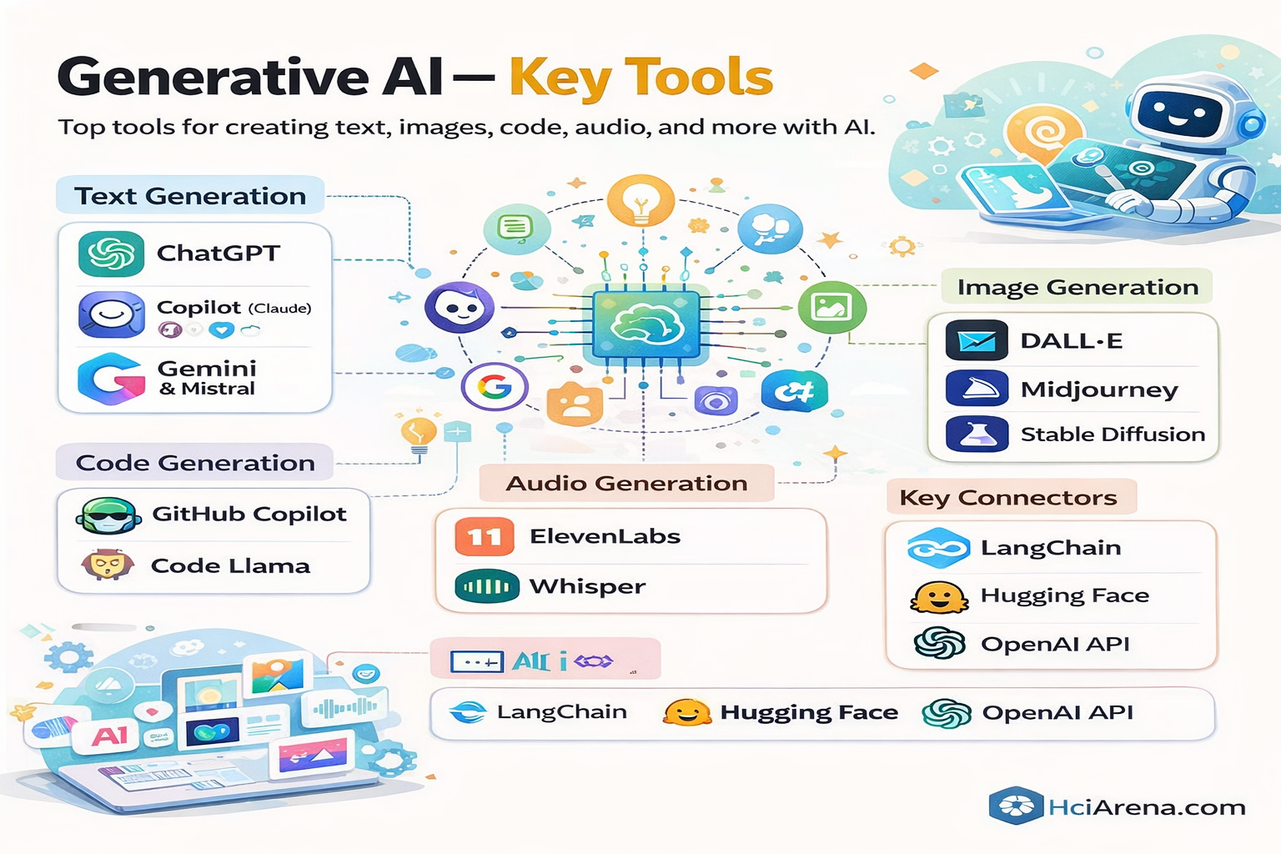

Slide 11
SIMPLE MCQs
Q1. Who proposed the Turing Test? A) John McCarthy B) Alan Turing C) Geoffrey Hinton D) Elon Musk
Q2. Early AI systems mainly worked on: A) Learning from data B) Neural networks C) Fixed rules D) Cloud computing

Slide 12
Q3. AI Winter refers to: A) Cold weather computing B) Slow internet C) Decline in AI funding and progress D) AI security issues
Q4. Which factor helped AI grow rapidly after 2010? A) Less data B) Slower CPUs C) Powerful GPUs D) Rule-based systems

Slide 13
Q5. Generative AI is mainly used to: A) Store data B) Create new content C) Only predict values D) Replace databases

Slide 14
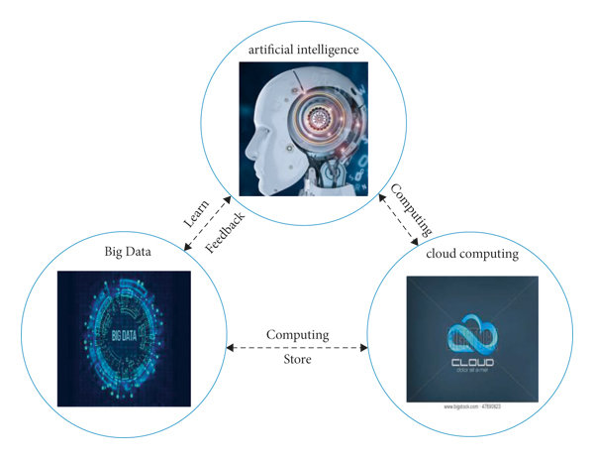
WHY AI IS BOOMING NOW?
Why AI is Growing Rapidly?
Big data availability
Powerful GPUs
Cloud computing
Better algorithms
Open-source tools
Formula: Data + Compute + Algorithms = AI Boom

Slide 15
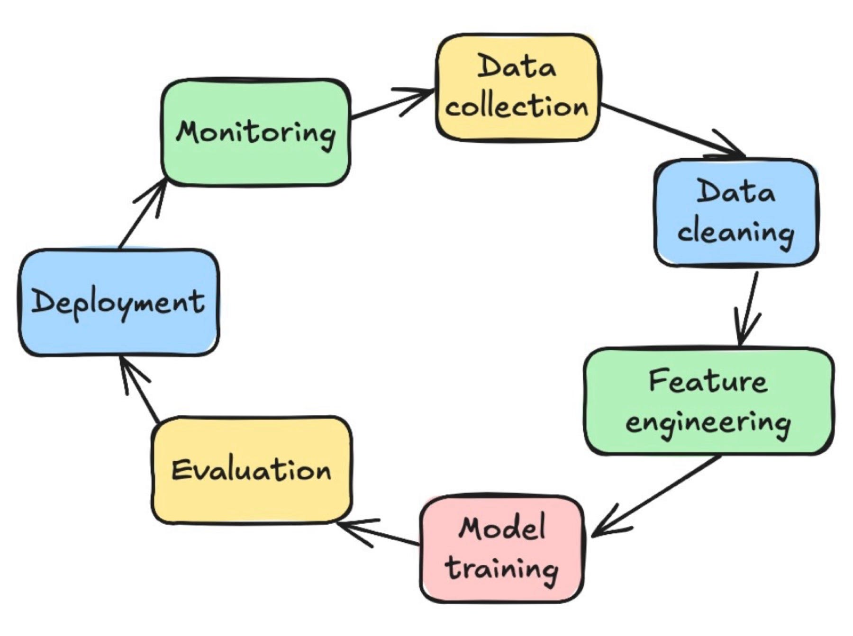
ML PROJECT LIFECYCLE
ML Project Lifecycle
Problem Definition
Data Collection
Data Preprocessing
Model Selection
Training
Evaluation
Deployment
Monitoring

Slide 16
TRADITIONAL AI vs GENERATIVE AI
Traditional AI | Generative AI
Predicts | Creates
Fixed output | Creative output
Rule-based | Data-driven
Limited interaction | Conversational

Slide 17
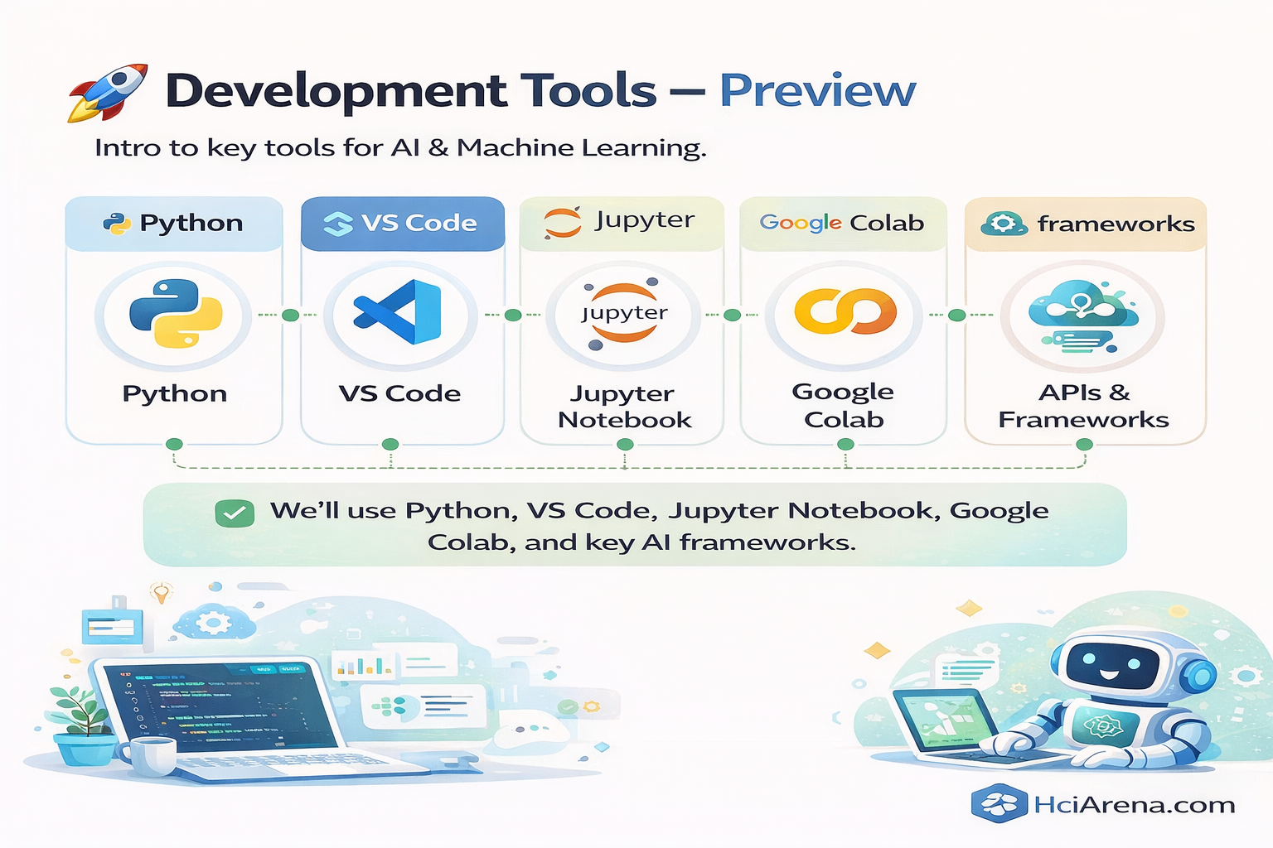

Slide 18
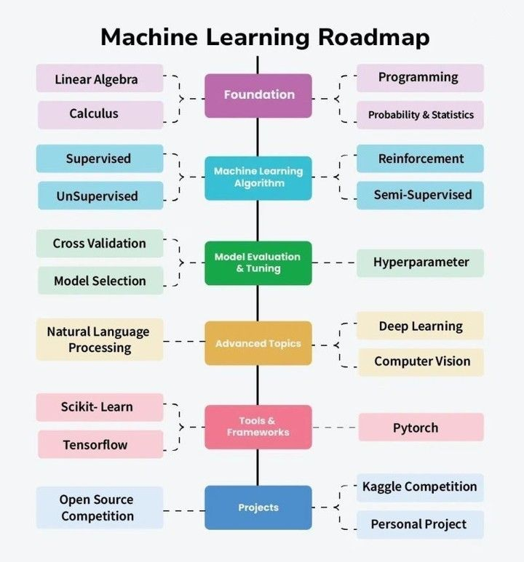

Slide 19

Python for AI & Machine Learning
Why we start with Python?
Python is the language of AI
Easy to learn, powerful to use
Used in industry + research

Slide 20
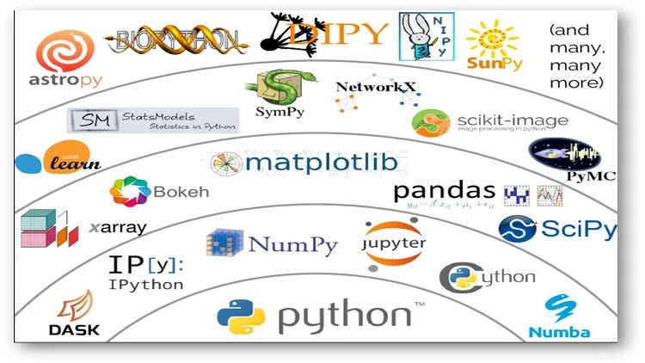
Why Python is #1 for AI
Why Python for AI & ML?
Simple & readable syntax
Huge AI ecosystem (NumPy, Pandas, TensorFlow)
Fast prototyping
Industry & academic standard
You focus on logic, not syntax

Slide 21
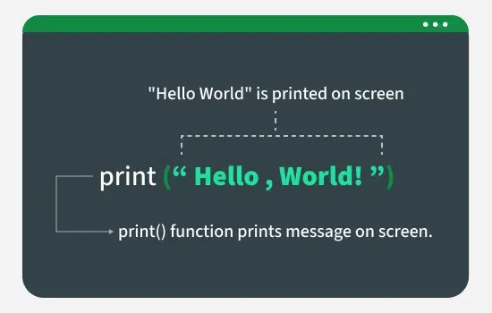
Your First AI Code
print("Welcome to AI & Machine Learning")
Try:
Print your name
Simple calculation

Slide 22
Python Basics
Python Topics
Arrays (NumPy)
DataFrames (Pandas)
Data Manipulation
These are the foundation of all AI work

Slide 23
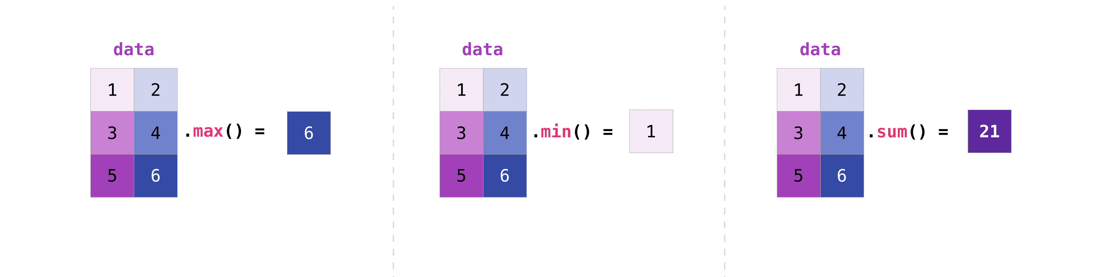
Python for Numbers – NumPy (Preview)
NumPy Arrays
Used for numerical data
Faster than normal Python lists
Base of ML & Deep Learning
ML models work on numbers
Memory Tip:
NumPy = Numbers

Slide 24
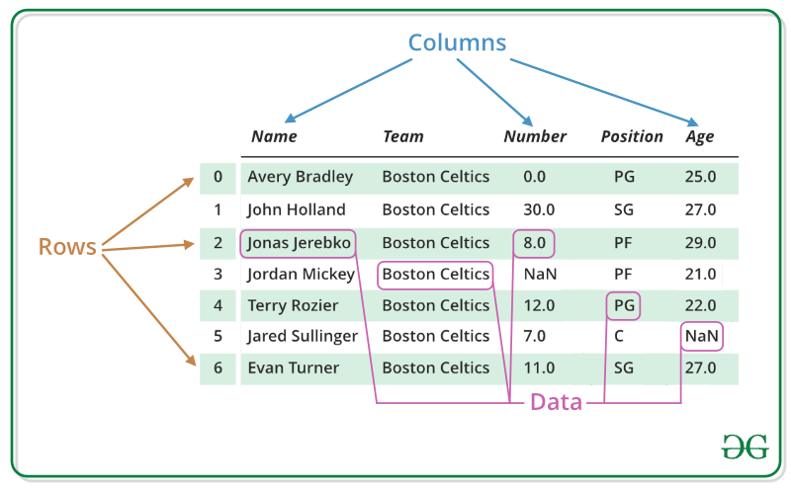
Python for Tables – Pandas (Preview)
Pandas DataFrames
Data in rows & columns
Like Excel in Python
Used with real datasets (CSV, Excel)
Most AI datasets use Pandas
Memory Tip:
Pandas = Tables

Slide 25
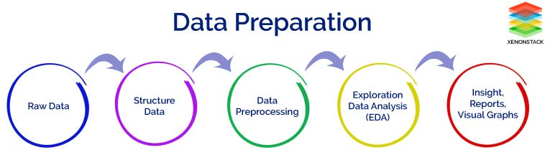
Data Manipulation (Very Important)
Data Manipulation
Using Python we:
Filter data
Sort data
Clean missing values
Prepare data for ML
70% of AI work is data handling
Memory Tip:
Manipulation = Cleaning

Slide 26
TASK 1: NumPy Arrays (Numbers)
Objective
Understand how AI works with numerical data using NumPy arrays.
Task
Create a NumPy array with the values: 5, 10, 15, 20, 25
Print the array
Find:
Sum
Mean
Maximum value
Starter Code
import numpy as np
arr = np.array([5, 10, 15, 20, 25])
print(arr)
Expected Output (Example)
[ 5 10 15 20 25 ] Sum: 75 Mean: 15.0 Max: 25

Slide 27
TASK 2: Pandas DataFrame (Tables)
Objective
Work with tabular data (rows & columns) like Excel.
Task
Create a DataFrame with:
Student Name
Age
Marks
Print the DataFrame
Display only the Marks column
Starter Code
import pandas as pd
data =
{ "Name": ["Ali", "Sara", "Ahmed"], "Age": [20, 21, 22], "Marks": [85, 90, 78] }
df = pd.DataFrame(data)
print(df)

Slide 28
Expected Output
Name Age Marks
0 Ali 20 85
1 Sara 21 90
2 Ahmed 22 78

Slide 29
TASK 3: Data Manipulation (Cleaning & Filtering)
Objective
Prepare data before training ML models.
Task
Using the previous DataFrame:
Filter students with Marks > 80
Sort students by Marks
Add a new column Result
Pass if Marks ≥ 80
Fail otherwise

Slide 30
import pandas as pd
df = pd.read_csv("data/StudentsPerformance.csv")
print(df.head())

